Slide 1

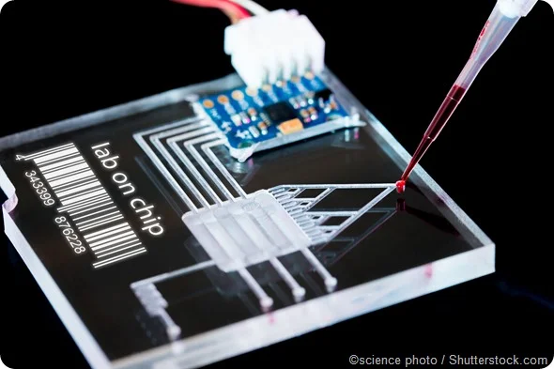

Final Demo
Interdigitated Electrodes for Droplet Sorting in Microfluidics
Erin Ingram & Omar Mahmood
Faculty: Dr. Arum Han, Dr. Han Zhang
NanoBio Systems Lab
Notes:
Erin

Slide 2
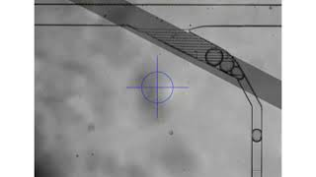
5μm IDE
Sorting out Large droplets
(>90 microns)
89.8%
efficiency

Slide 3
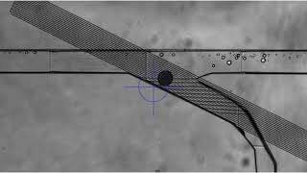
10μm IDE
Sorting out Large droplets
(>90 microns)
96.2%
efficiency

Slide 4
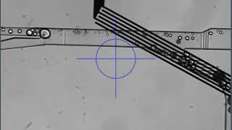
20μm IDE
Sorting out Large droplets
(>90 microns)
77.2%
efficiency
Lots of false positives! This E-field reaches higher than the others, so it interacts with the smaller droplets more, making it harder to affect only larger droplets.

Slide 5
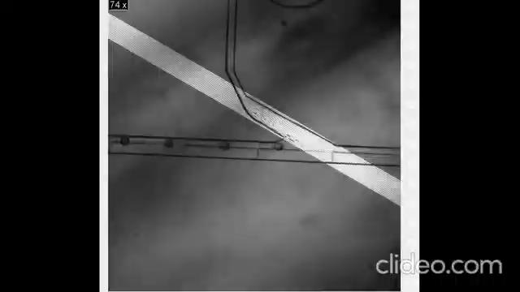
Threshold Voltage (Trial 1)
Droplet Size (um) | Threshold Voltage (mV)
90 | 90 87.5 Average

Slide 6

Threshold Voltage (Trial 2)
Droplet Size (um) | Threshold Voltage (mV)
100 | 120 122.5 Average
**Same procedure for all droplet sizes tested

Slide 7
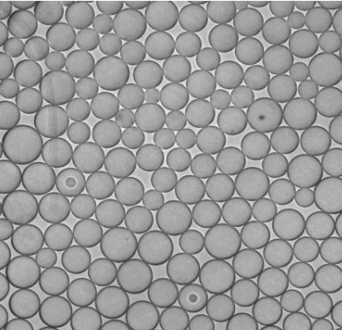
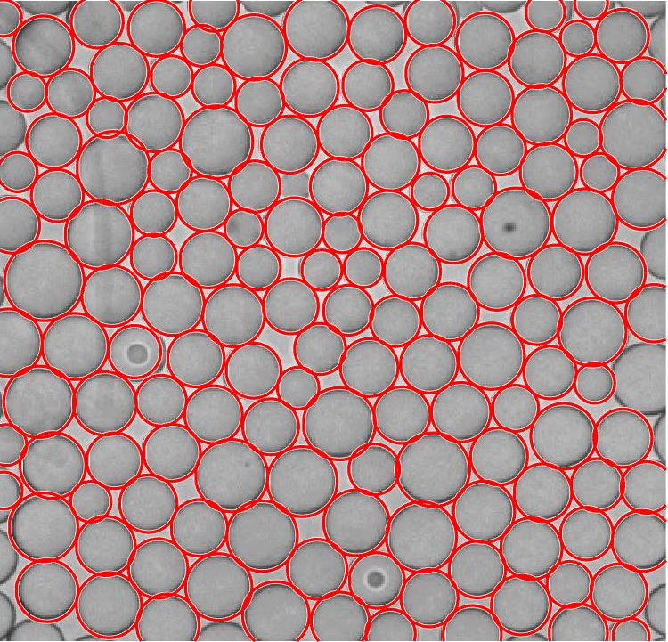
Image Processing
New method – collecting and imaging outputs

Slide 8
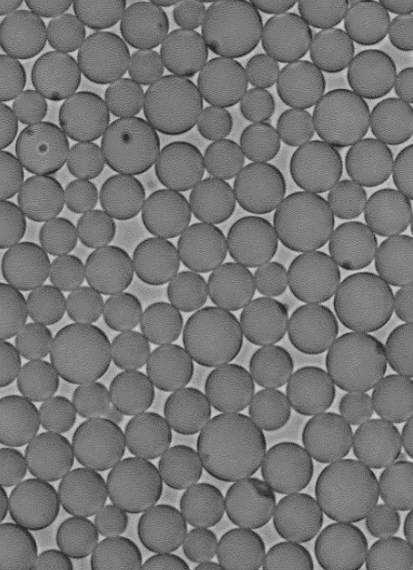
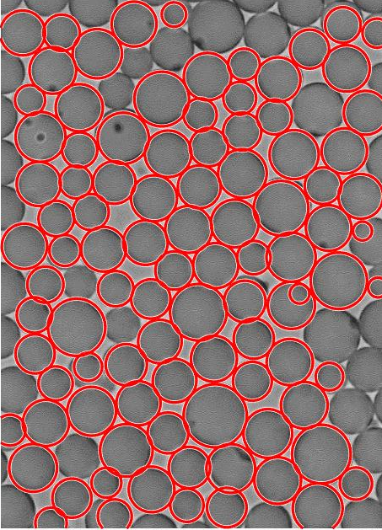
Image Processing

Slide 9
Thanks! Questions?

Slide 10
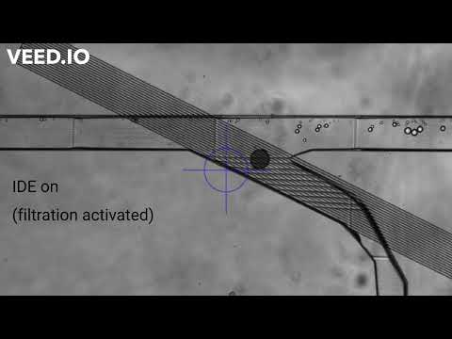
High-pass Filter Validation
Sorting out Large droplets
(>100 microns)
96%
efficiency

Slide 11
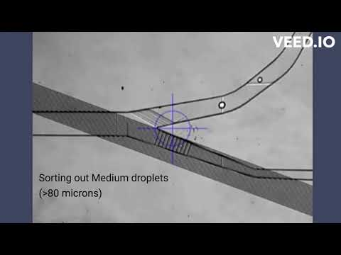
Band-pass Filter Validation
1st stage:
93%
efficiency
2nd stage:
92%
efficiency

Slide 12
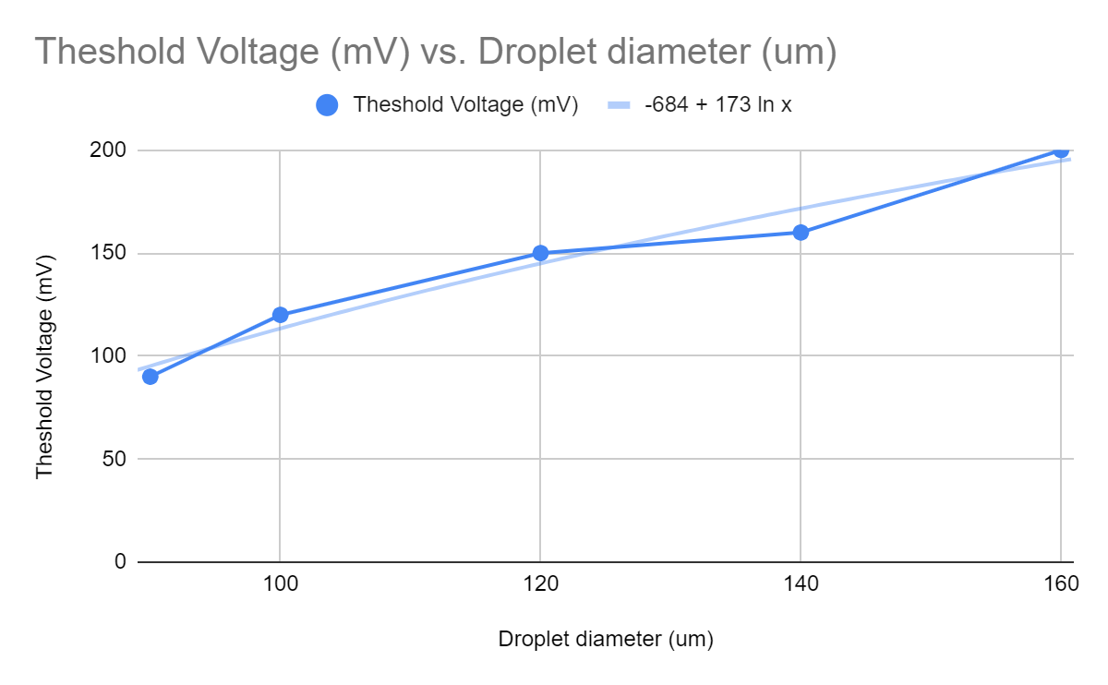
Threshold Voltage Trendline

